Slide 1
Definitions Injections, Surjections and Inverse Functions Composition of Functions
Lecture 7: Functions
Aaron Tan
Part of the contents here is taken from Dr Wong Tin Lok’s lecture notes.
AY2023/24 Semester 2

Slide 2
Definitions Injections, Surjections and Inverse Functions Composition of Functions
Functions in C programming:
int f(int x, double y) {
return x * sqrt(y);
}
Many built-in math functions in C:
floor(), round()
ceil(), floor()
sin(), cos(), tan()
log(), log10()
sqrt(), pow()
etc.
Lecture 7: Functions
f(3, 4) → 6.0
f(4, 3) → 6.928203
f(6, 1) → 6.0
Applications of function in Computer Science: computational complexity of algorithms, counting objects, study of sequences and strings, etc.

Slide 3
Definitions Injections, Surjections and Inverse Functions Composition of Functions
7. Functions
7.1 Definitions
Definitions of function, arrow diagram, image, pre-image, setwise image, setwise preimage, domain, co-domain, range.
7.2 Injections, Surjections, Bijections and Inverse Functions
Injections, surjections, bijections.
Function equality.
Inverse functions.
7.3 Composition of Functions
Sequences, strings.
Bijectivity and invertibility.
Composition with the identity function; composition with its inverse.
Associativity and noncommutativity of function composition.
Composition of injections; composition of bijections.
7.4 Addition and Multiplication on $ℤ_{n}$
Reference: Epp’s Chapter 7 Functions

Slide 4
Definitions Injections, Surjections and Inverse Functions Composition of Functions
Recapitulation

Slide 5



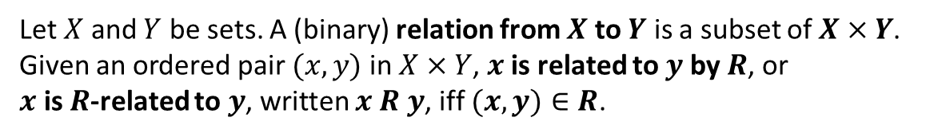















Definitions Injections, Surjections and Inverse Functions Composition of Functions
Recapitulation
Definition: Relation
Let $X$ and $Y$ be sets. A (binary) relation from $X$ to $Y$ is a subset of $X×Y$.
Given an ordered pair $(x,y)$in $X×Y$, $x$ is related to $y$ by $R$, or
$x$ is $R$-related to $y$, written $x R y$, iff $(x,y)∈R$.
$$X$$
$$R_{1}$$
$$Y$$
$$X$$
$$R_{2}$$
$$Y$$
$$X$$
$$R_{3}$$
$$Y$$
$$X$$
$$R_{4}$$
$$Y$$
$$X$$
$$R_{5}$$
$$Y$$
$$X$$
$$R_{6}$$
$$Y$$

Slide 6
Definitions Injections, Surjections and Inverse Functions Composition of Functions
7.1 Definitions

Slide 7
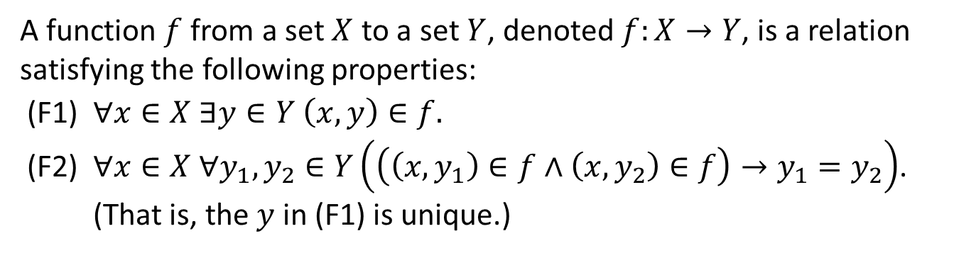
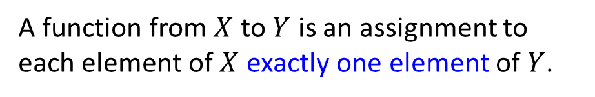
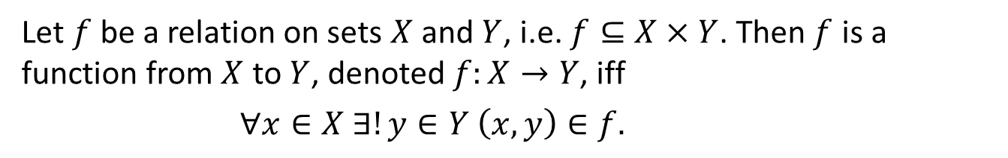
Definitions Injections, Surjections and Inverse Functions Composition of Functions
Definitions: Function
7.1.1 Definitions
Definition: Function
A function $f$ from a set $X$ to a set $Y$, denoted $f:X→Y$, is a relation satisfying the following properties:
(F1) $∀x∈X ∃y∈Y \left(x,y\right)∈f.$
(F2) $∀x∈X ∀y_{1},y_{2}∈Y\left(\left(\left(x,y_{1}\right)∈f∧\left(x,y_{2}\right)∈f\right)→y_{1}=y_{2}\right)$. (That is, the $y$ in (F1) is unique.)
Or alternatively,
Let $f$be a relation on sets $X$ and $Y$, i.e. $f⊆X×Y$. Then $f$ is a function from $X$ to $Y$, denoted $f:X→Y$, iff
$∀x∈X ∃!y∈Y \left(x,y\right)∈f.$
Informally,
A function from $X$ to $Y$ is an assignment to each element of $X$ exactly one element of $Y$.

Slide 8
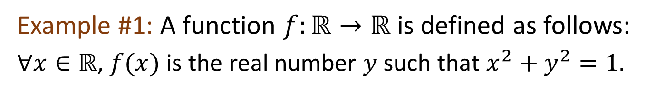
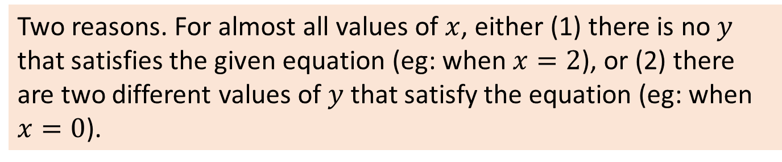
Definitions Injections, Surjections and Inverse Functions Composition of Functions
Definitions: Function
Example #1: A function $f:ℝ→ℝ$ is defined as follows:
$∀x∈ℝ$, $f(x)$ is the real number $y$ such that $x^{2}+y^{2}=1.$
No!
Is the above a function?
Two reasons. For almost all values of $x$, either (1) there is no $y$ that satisfies the given equation (eg: when $x=2$), or (2) there are two different values of $y$ that satisfy the equation (eg: when $x=0$).

Slide 9
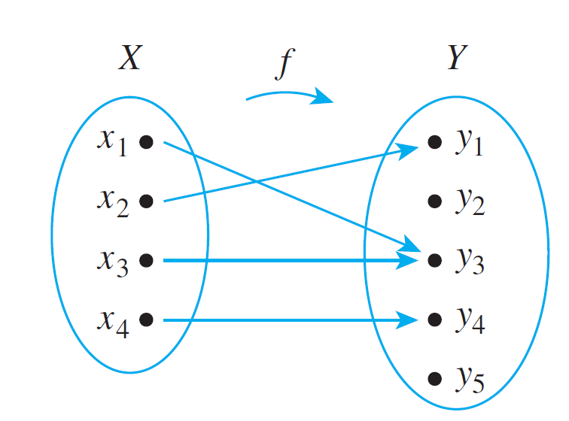
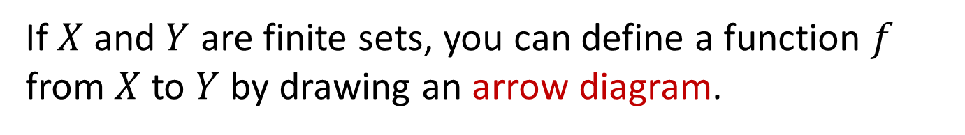
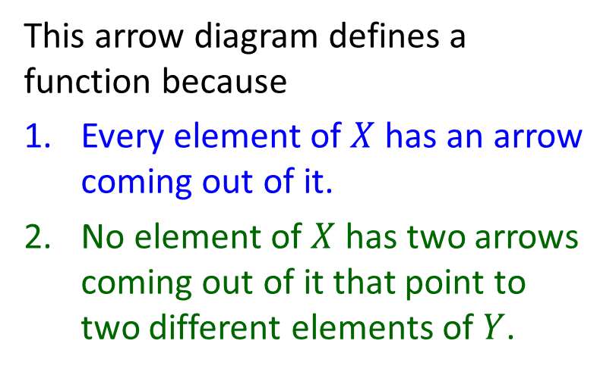
Definitions Injections, Surjections and Inverse Functions Composition of Functions
Definitions: Arrow Diagrams
If $X$ and $Y$ are finite sets, you can define a function $f$ from $X$ to $Y$ by drawing an arrow diagram.
This arrow diagram defines a function because
Every element of $X$ has an arrow coming out of it.
No element of $X$ has two arrows coming out of it that point to two different elements of $Y$.
Figure 7.1.1

Slide 10













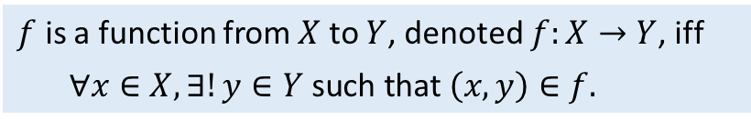




Definitions Injections, Surjections and Inverse Functions Composition of Functions
Arrow Diagrams
$f$ is a function from $X$ to $Y$, denoted $f:X→Y$, iff
$∀x∈X,∃!y∈Y \text{such} \text{that} \left(x,y\right)∈f.$
Example #2: Which of the following relations are functions and which are not? Why?
$$X$$
$$R_{1}$$
$$Y$$
$$X$$
$$R_{2}$$
$$Y$$
$$X$$
$$R_{3}$$
$$Y$$
$$X$$
$$R_{4}$$
$$Y$$
$$X$$
$$R_{5}$$
$$Y$$
$$X$$
$$R_{6}$$
$$Y$$


Slide 11
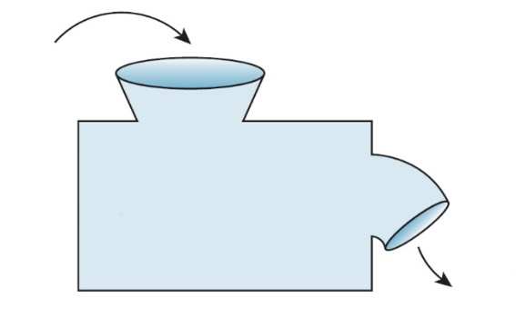
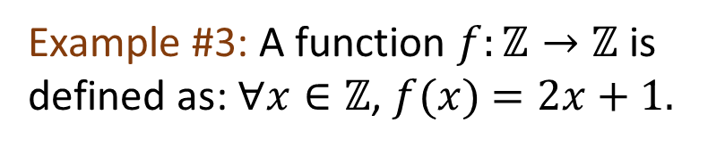
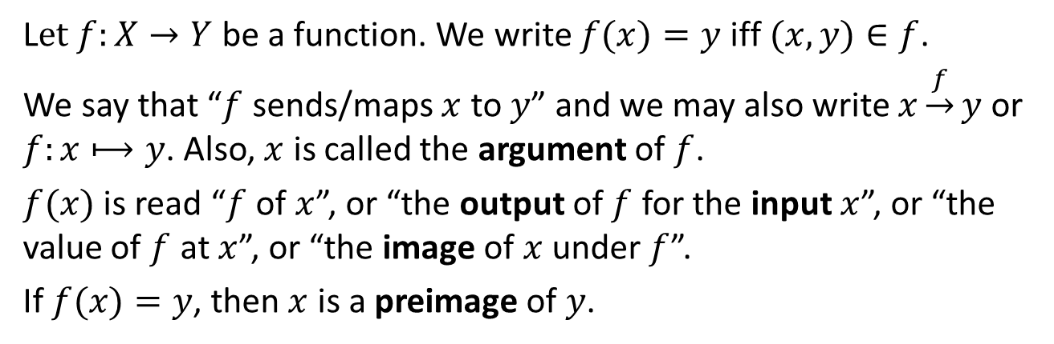



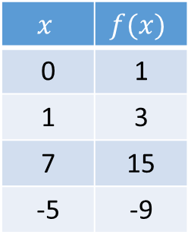
Definitions Injections, Surjections and Inverse Functions Composition of Functions
Definitions: Argument, image, preimage, input, output
Definitions: Argument, image, preimage , input, output
L$et f:X→Y$ be a function. We write $f(x)=y$iff $(x,y)∈f$.
We say that “$f$ sends/maps $x$ to $y$” and we may also write $x\underset{→}{f}y$ or $f:x⟼y$. Also, $x$ is called the argument of $f$.
$f(x)$ is read “$f$ of $x$”, or “the output of $f$ for the input $x$”, or “the value of $f$ at $x$”, or “the image of $x$ under $f$”.
If $f(x)=y$, then $x$ is a preimage of $y$.
Example #3: A function $f:ℤ→ℤ$ is defined as: $∀x∈ℤ$, $f(x)$ $=2x+1.$
input $x$
$$x$$ | $$f(x)$$
0 | 1
1 | 3
7 | 15
-5 | -9
$$f$$
output $f(x)$

Slide 12



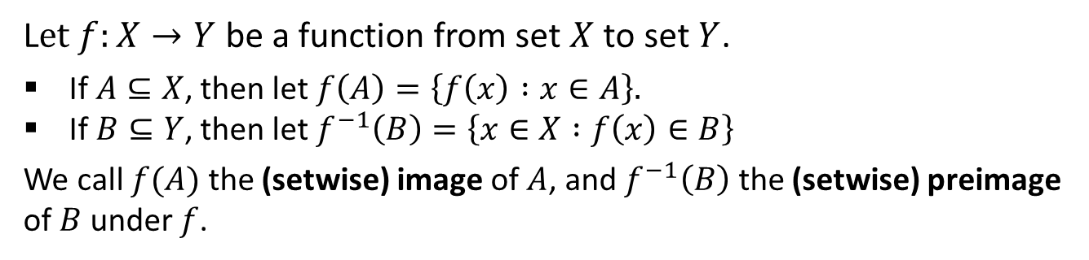




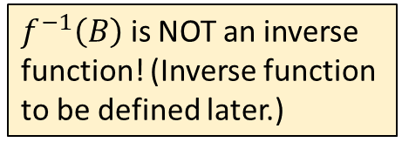




Definitions Injections, Surjections and Inverse Functions Composition of Functions
Definitions: Setwise image and preimage
Definitions: Setwise image and preimage
$f^{−1}\left(B\right)$ is NOT an inverse function! (Inverse function to be defined later.)
L$et f:X→Y$ be a function from set $X$ to set $Y$.
If $A⊆X$, then let $f\left(A\right)=\left\{f\left(x\right) :x∈A\right\}.$
If $B⊆Y$, then let $f^{−1}\left(B\right)=\left\{x∈X :f\left(x\right)∈B\right\}$
We call $f(A)$ the (setwise) image of $A$, and $f^{−1}\left(B\right)$ the (setwise) preimage of $B$ under $f$.
Note: We use different terminologies here from Susanna Epp’s as the latter may cause confusion.
$$X$$
$$f$$
$$Y$$
$$X$$
$$f$$
$$Y$$
$$A$$
$$f^{−1}(B)$$
$$f(A)$$
$$B$$

Slide 13

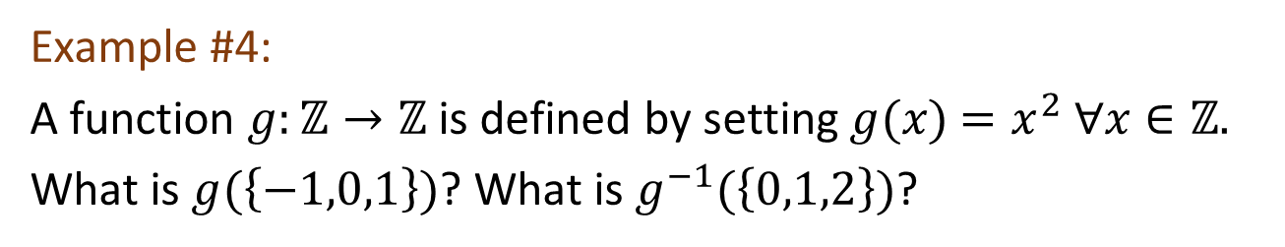






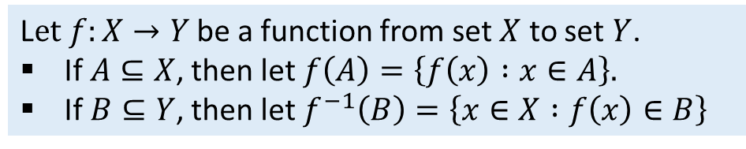



Definitions Injections, Surjections and Inverse Functions Composition of Functions
Definitions: Setwise image and preimage
$$X$$
$$f$$
$$Y$$
$$X$$
$$f$$
$$Y$$
$$A$$
$$f^{−1}(B)$$
$$f(A)$$
$$B$$
Example #4:
A function $g:ℤ→ℤ$ is defined by setting $g(x)$ $=x^{2} ∀x∈ℤ.$
What is $g(\left\{−1,0,1\right\})$? What is $g^{−1}(\left\{0,1,2\right\})$?
$$g\left(\left\{−1,0,1\right\}\right)=\left\{g\left(−1\right),g\left(0\right),g\left(1\right)\right\}=\left\{1,0,1\right\}=\left\{0,1\right\}.$$
$g^{−1}\left(\left\{0,1,2\right\}\right)=\left\{−1,0,1\right\}.$ (Because $g(0)=0$; $g(−1)=g(1)=1$.)
L$et f:X→Y$ be a function from set $X$ to set $Y$.
If $A⊆X$, then let $f\left(A\right)=\left\{f\left(x\right) :x∈A\right\}.$
If $B⊆Y$, then let $f^{−1}\left(B\right)=\left\{x∈X :f\left(x\right)∈B\right\}$

Slide 14
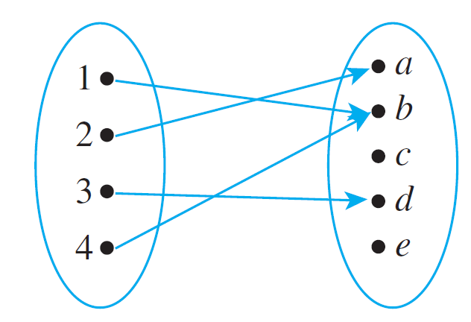

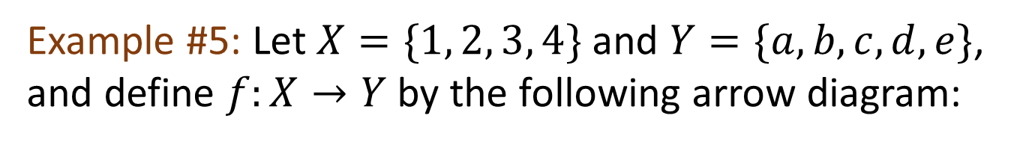


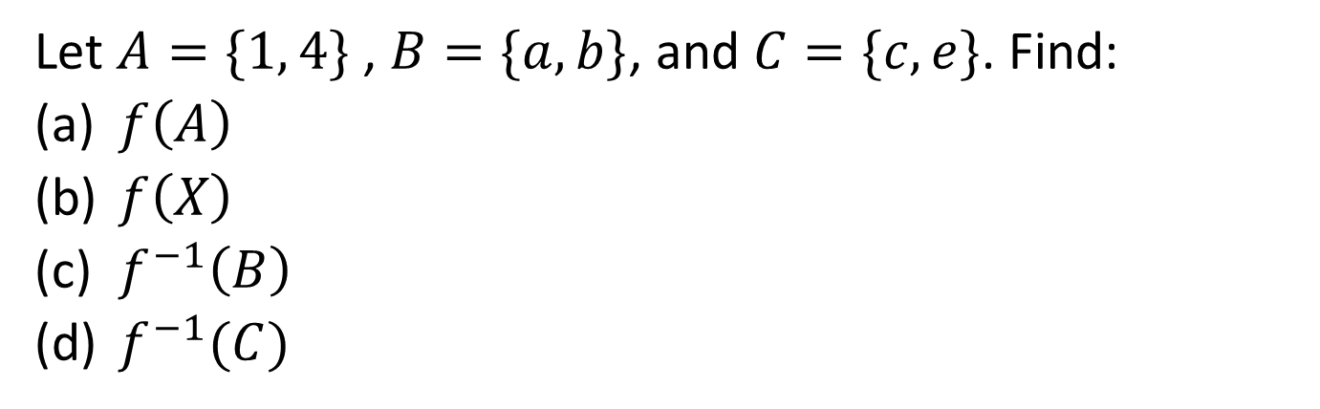

Definitions Injections, Surjections and Inverse Functions Composition of Functions
Definitions: Setwise image and preimage
Example #5: Let $X=\{1, 2, 3, 4\}$and $Y=\{a, b, c, d, e\}$, and define $f:X→Y$by the following arrow diagram:
Let $A=\{1, 4\}$, $B=\{a, b\}$, and $C=\{c, e\}$. Find:
(a) $f\left(A\right)$
(b) $f\left(X\right)$
(c) $f^{−1}\left(B\right)$
(d) $f^{−1}(C)$
$$\{b\}$$
$$\{a,b,d\}$$
$$\{1,2,4\}$$
$$∅$$


Slide 15
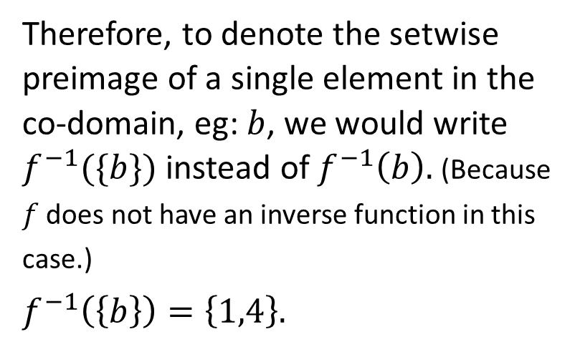
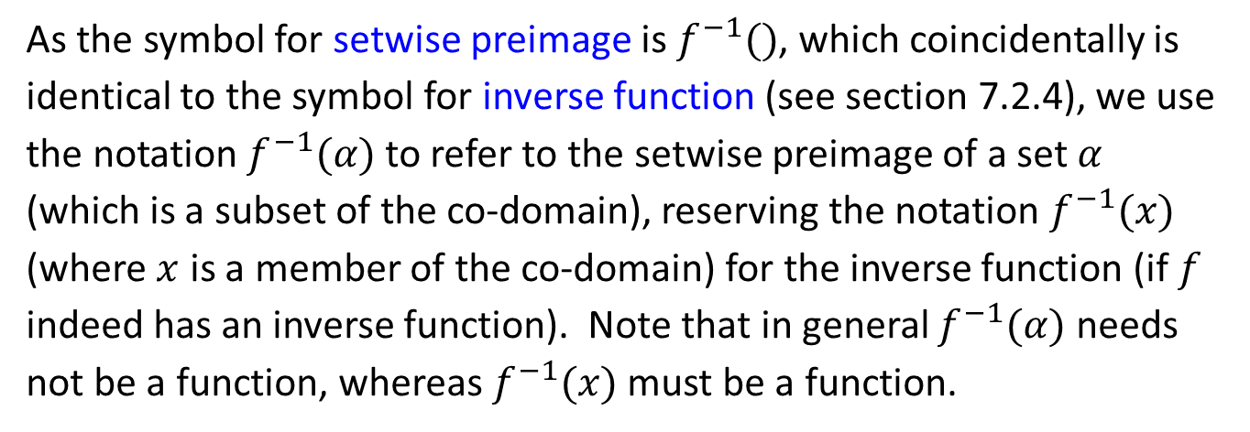
Definitions Injections, Surjections and Inverse Functions Composition of Functions
Definitions: Setwise image and preimage
As the symbol for setwise preimage is $f^{−1}()$, which coincidentally is identical to the symbol for inverse function (see section 7.2.4), we use the notation $f^{−1}(α)$ to refer to the setwise preimage of a set $α$ (which is a subset of the co-domain), reserving the notation $f^{−1}(x)$ (where $x$ is a member of the co-domain) for the inverse function (if $f$ indeed has an inverse function). Note that in general $f^{−1}(α)$ needs not be a function, whereas $f^{−1}(x)$ must be a function.
Therefore, to denote the setwise preimage of a single element in the co-domain, eg: $b$, we would write $f^{−1}(\{b\})$ instead of $f^{−1}\left(b\right).$ (Because $f$ does not have an inverse function in this case.)
$$f^{−1}\left(\left\{b\right\}\right)=\left\{1,4\right\}.$$

Slide 16
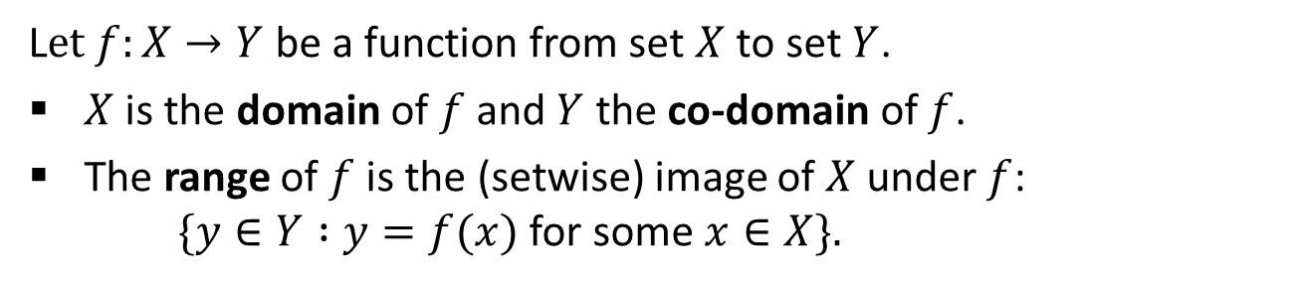

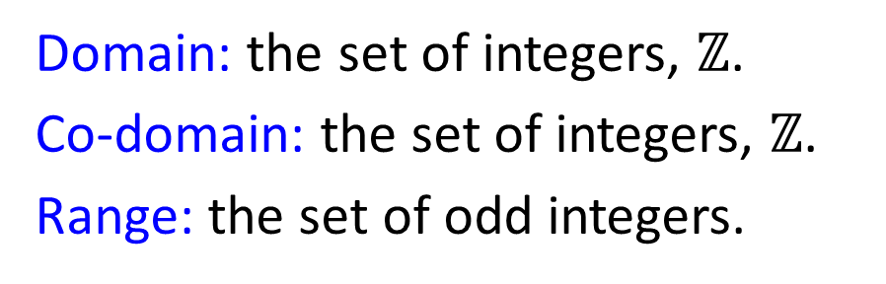
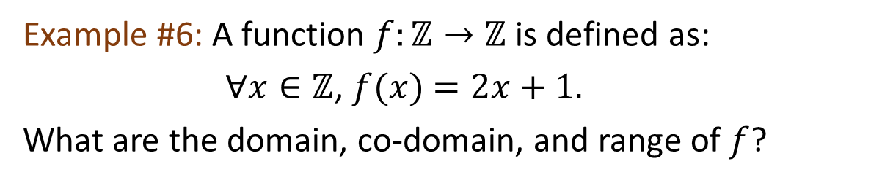
Definitions Injections, Surjections and Inverse Functions Composition of Functions
Definitions: Domain, co-domain, range
Definitions: Domain, co-domain, range
L$et f:X→Y$ be a function from set $X$ to set $Y$.
$X$ is the domain of $f$ and $Y$ the co-domain of $f$.
The range of $f$ is the (setwise) image of $X$ under $f$:
$\{y∈Y :y=f(x)$ for some $x∈X\}.$
Range $⊆$ Co-domain
Example #6: A function $f:ℤ→ℤ$ is defined as:
$∀x∈ℤ$, $f(x)$ $=2x+1.$
What are the domain, co-domain, and range of $f$?
Domain: the set of integers, $ℤ$.
Co-domain: the set of integers, $ℤ$.
Range: the set of odd integers.

Slide 17
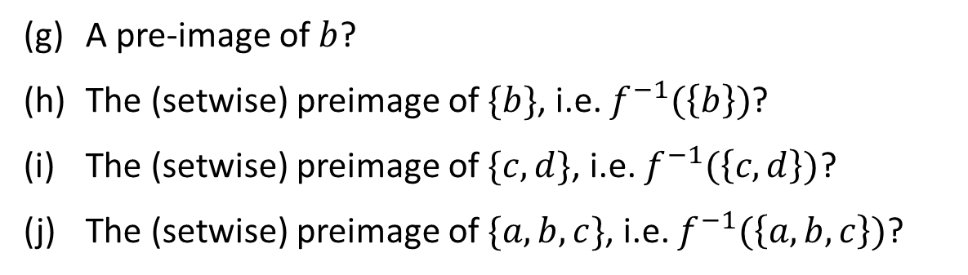


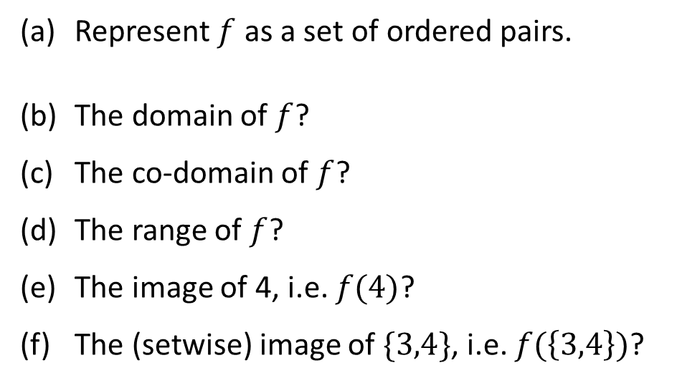












Definitions Injections, Surjections and Inverse Functions Composition of Functions
Definitions: Domain, co-domain, range
Example #7: The function $f:X→Y$ is shown below.
(a) Represent $f$ as a set of ordered pairs.
(b) The domain of $f$?
(c) The co-domain of $f$?
(d) The range of $f$?
(e) The image of 4, i.e. $f(4)$?
(f) The (setwise) image of $\{3,4\}$, i.e. $f(\left\{3,4\right\})$?
$$f$$
$$\{\left(1,a\right),\left(2,b\right),\left(3,b\right),\left(4,e\right)\}$$
$$X$$
$$Y$$
1
$$X$$
or
$$\{1,2,3,4\}$$
a
2
b
$$Y$$
$$\{a,b,c,d,e\}$$
c
or
3
d
$$\{a,b,e\}$$
4
e
$$e$$
$$\{b,e\}$$
2
3
(g) A pre-image of $b$?
(h) The (setwise) preimage of $\{b\}$, i.e. $f^{−1}(\left\{b\right\})$?
(i) The (setwise) preimage of $\{c,d\}$, i.e. $f^{−1}(\left\{c,d\right\})$?
(j) The (setwise) preimage of $\{a,b,c\}$, i.e. $f^{−1}(\left\{a,b,c\right\})$?
or
$$\{2,3\}$$
$$∅$$
$$\{1,2,3\}$$


Slide 18
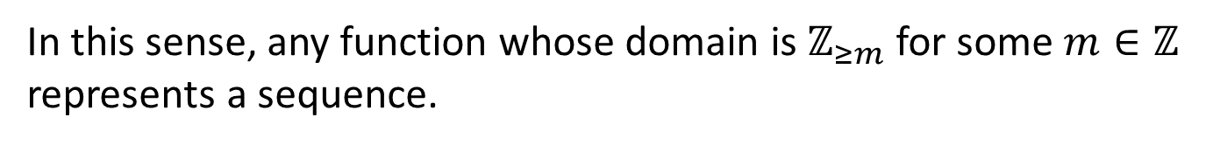
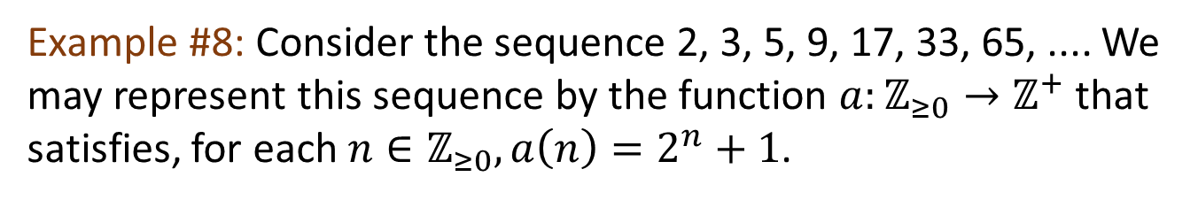

Definitions Injections, Surjections and Inverse Functions Composition of Functions
Sequences and Strings
7.1.2 Sequences and Strings
Definition: Sequence
A sequence $a_{0},a_{1},a_{2},⋯$ can be represented by a function $a$ whose domain is $ℤ_{≥0}$ that satisfies $a(n)=a_{n}$ for every $n∈ℤ_{≥0}$.
In this sense, any function whose domain is $ℤ_{≥m}$ for some $m∈ℤ$ represents a sequence.
Example #8: Consider the sequence 2, 3, 5, 9, 17, 33, 65, .... We may represent this sequence by the function $a:ℤ_{≥0}→ℤ^{+}$ that satisfies, for each $n∈ℤ_{≥0},a\left(n\right)=2^{n}+1$.

Slide 19
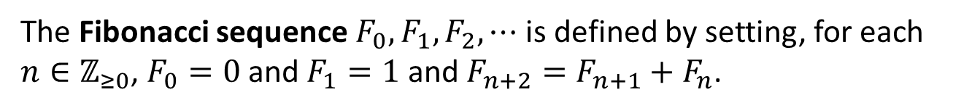
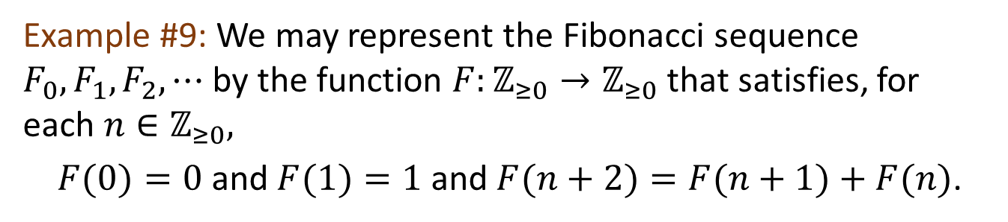
Definitions Injections, Surjections and Inverse Functions Composition of Functions
Sequences and Strings
Definition: Fibonacci Sequence
The Fibonacci sequence $F_{0},F_{1},F_{2},⋯$ is defined by setting, for each $n∈ℤ_{≥0}$, $F_{0}=0$ and $F_{1}=1$ and $F_{n+2}=F_{n+1}+F_{n}$.
Fibonacci sequence: 0, 1, 1, 2, 3, 5, 8, 13, 21, 34, 55, …
Example #9: We may represent the Fibonacci sequence $F_{0},F_{1},F_{2},⋯$ by the function $F:ℤ_{≥0}→ℤ_{≥0}$ that satisfies, for each $n∈ℤ_{≥0},$
$F(0)=0 \text{and} F(1)=1 \text{and} F(n+2)=F(n+1)+F(n)$.

Slide 20
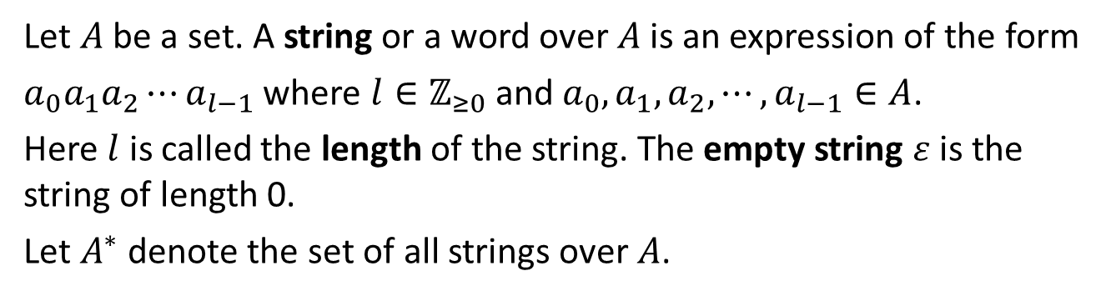
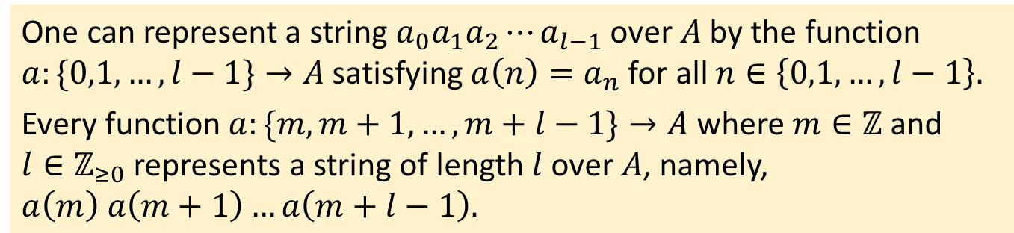

Definitions Injections, Surjections and Inverse Functions Composition of Functions
Sequences and Strings
Definition: String
Let $A$ be a set. A string or a word over $A$ is an expression of the form
$a_{0}a_{1}a_{2}⋯a_{l−1}$ where $l∈ℤ_{≥0}$ and $a_{0},a_{1},a_{2},⋯,a_{l−1}∈A$.
Here $l$ is called the length of the string. The empty string $ε$ is the string of length 0.
Let $A^{∗}$ denote the set of all strings over $A$.
Example #10: Let $A=\left\{s,u\right\}.$ Some strings over $A$ are $s, ssuu,$ $susuussu$ and $uuuuuuu$with lengths 1, 4, 8 and 7 respectively.
One can represent a string $a_{0}a_{1}a_{2}⋯a_{l−1}$ over $A$ by the function $a:\{0,1,…,l−1\}→A$ satisfying $a\left(n\right)=a_{n}$ for all $n∈\left\{0,1,…,l−1\right\}.$
Every function $a:\{m,m+1,…,m+l−1\}→A$ where $m∈ℤ$ and
$l∈ℤ_{≥0}$ represents a string of length $l$ over $A$, namely,
$$a\left(m\right) a\left(m+1\right)…a\left(m+l−1\right).$$

Slide 21
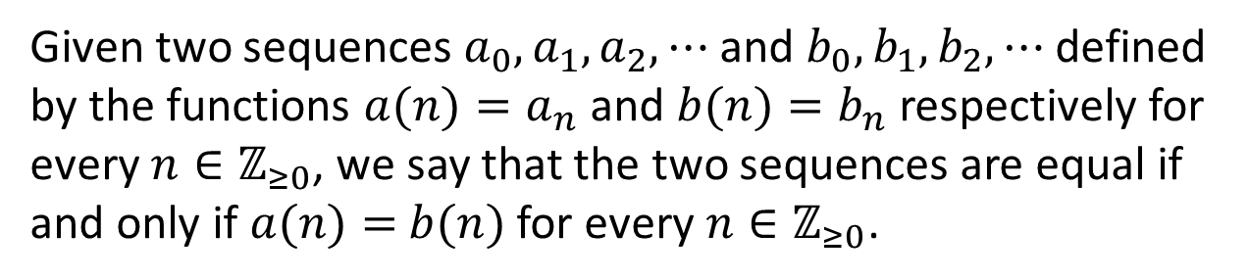
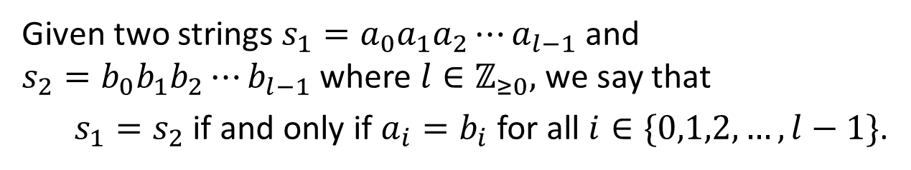
Definitions Injections, Surjections and Inverse Functions Composition of Functions
Sequences and Strings
Equality of Sequences
Given two sequences $a_{0},a_{1},a_{2},⋯$ and $b_{0},b_{1},b_{2},⋯$ defined by the functions $a(n)=a_{n}$ and $b(n)=b_{n}$ respectively for every $n∈ℤ_{≥0}$, we say that the two sequences are equal if and only if $a(n)=$ $b(n)$ for every $n∈ℤ_{≥0}$.
Equality of Strings
Given two strings ${s_{1}=a}_{0}a_{1}a_{2}⋯a_{l−1}$ and ${s_{2}=b}_{0}b_{1}b_{2}⋯b_{l−1}$where $l∈ℤ_{≥0},$ we say that
${s_{1}=s}_{2}$ if and only if $a_{i}=b_{i}$ for all $i∈\{0,1,2,…,l−1\}$.

Slide 22
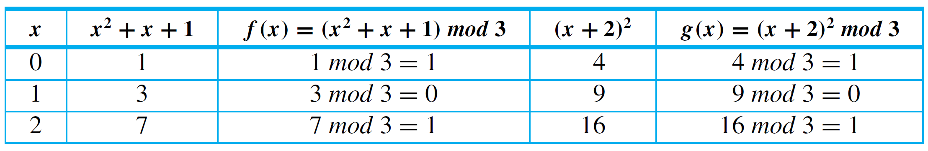
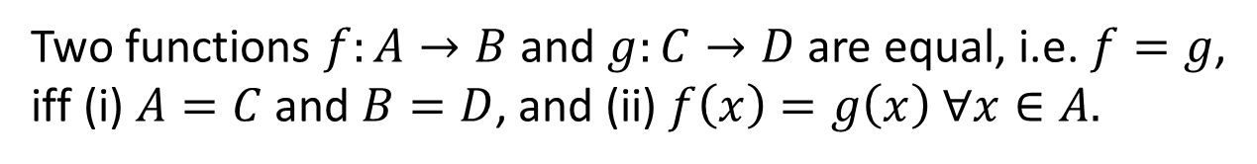

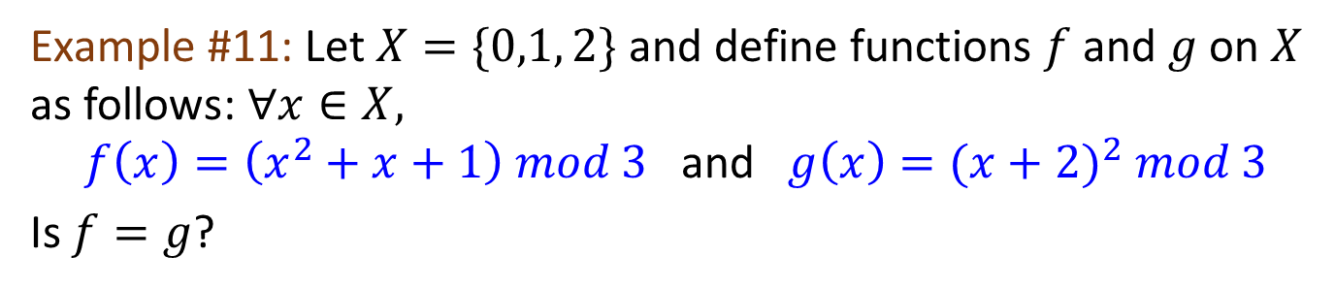
Definitions Injections, Surjections and Inverse Functions Composition of Functions
Function Equality
7.1.3 Function Equality
Theorem 7.1.1 Function Equality
Two functions $f:A→B$ and $g:C→D$ are equal, i.e. $f=g$, iff (i) $A=C$and $B=D$, and (ii) $f\left(x\right)=g\left(x\right) ∀x∈A.$
Example #11: Let $X=\{0,1, 2\}$ and define functions $f$ and $g$ on $X$ as follows: $∀x∈X,$
$f\left(x\right)=\left(x^{2}+x+1\right) mod 3$ and $g\left(x\right)={(x+2)}^{2} mod 3$
Is $f=g$?
Note: $a mod b$computes the remainder of $a÷b$.
Yes.

Slide 23
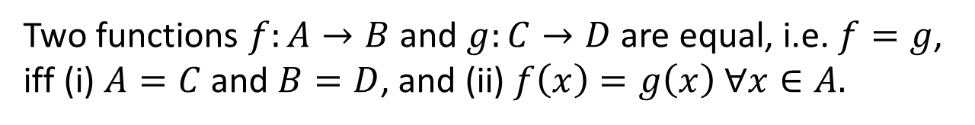
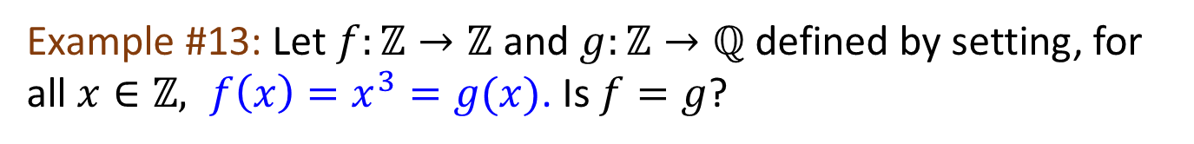
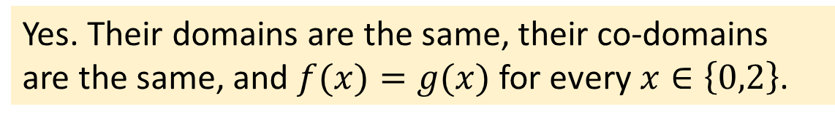
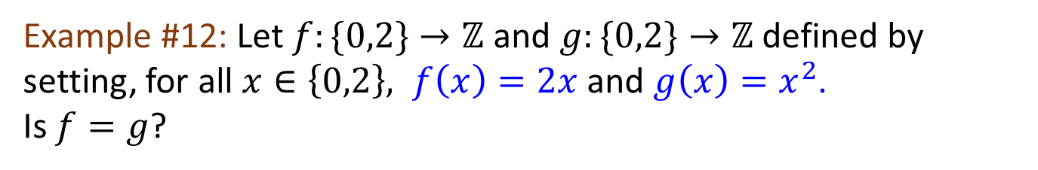
Definitions Injections, Surjections and Inverse Functions Composition of Functions
Function Equality
Theorem 7.1.1 Function Equality
Two functions $f:A→B$ and $g:C→D$ are equal, i.e. $f=g$, iff (i) $A=C$and $B=D$, and (ii) $f\left(x\right)=g\left(x\right) ∀x∈A.$
Example #12: Let $f:\{0,2\}→ℤ$ and $g:\{0,2\}→ℤ$ defined by setting, for all $x∈\left\{0,2\right\}, f\left(x\right)=2x$ and $g\left(x\right)=x^{2}$.
Is $f=g$?
Yes. Their domains are the same, their co-domains are the same, and $f(x)=g(x)$ for every $x∈\left\{0,2\right\}$.
Example #13: Let $f:ℤ→ℤ$ and $g:ℤ→ℚ$ defined by setting, for all $x∈ℤ, f\left(x\right)=x^{3}=g(x)$. Is $f=g$?
No, because their co-domains are different.

Slide 24
Definitions Injections, Surjections and Inverse Functions Composition of Functions
7.2 Injections, Surjections, Bijections
and Inverse Functions

Slide 25
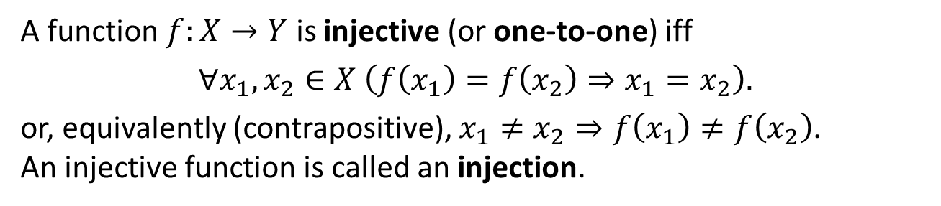
Definitions Injections, Surjections and Inverse Functions Composition of Functions
Injections (One-to-One Functions)
7.2.1 Injections (One-to-One Functions)
Definition: Injection (one-to-one function)
A function$f:X→Y$ is injective (or one-to-one) iff
$$∀x_{1},x_{2}∈X \left(f\left(x_{1}\right)=f\left(x_{2}\right)⇒x_{1}=x_{2}\right).$$
or, equivalently (contrapositive), $x_{1}≠x_{2}⇒f\left(x_{1}\right)≠f\left(x_{2}\right)$.
An injective function is called an injection.
Which of the following is/are injections?
$$X$$
$$R_{4}$$
$$Y$$
$$X$$
$$R_{5}$$
$$Y$$
$$X$$
$$R_{6}$$
$$Y$$
Injection
Not injection
Injection


Slide 26
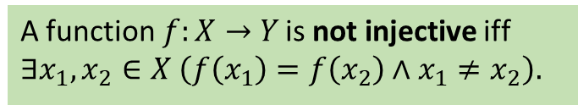
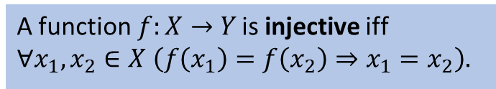
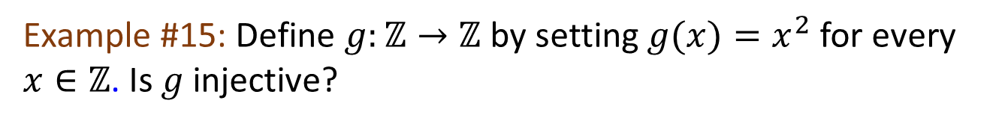
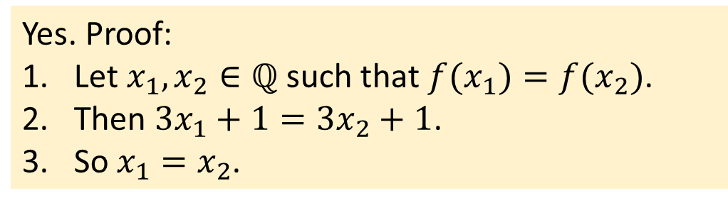
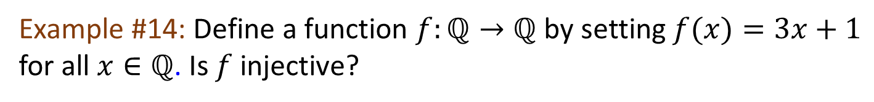
Definitions Injections, Surjections and Inverse Functions Composition of Functions
Injections (One-to-One Functions)
A function$f:X→Y$ is injective iff
$$∀x_{1},x_{2}∈X \left(f\left(x_{1}\right)=f\left(x_{2}\right)⇒x_{1}=x_{2}\right).$$
A function$f:X→Y$ is not injective iff
$$∃x_{1},x_{2}∈X \left(f\left(x_{1}\right)=f\left(x_{2}\right)∧x_{1}≠x_{2}\right).$$
Example #14: Define a function $f:ℚ→ℚ$ by setting $f(x)=3x+1$ for all $x∈ℚ$. Is $f$ injective?
Yes. Proof:
1. Let $x_{1},x_{2}∈ℚ$ such that ${f(x}_{1})=f(x_{2})$.
2. Then $3x_{1}+1=3x_{2}+1$.
3. So $x_{1}=x_{2}$.
Example #15: Define $g:ℤ→ℤ$ by setting $g(x)=x^{2}$ for every $x∈ℤ$. Is $g$ injective?
No. $g\left(1\right)=1^{2}=1={(−1)}^{2}=g(−1)$, but $1≠−1.$

Slide 27
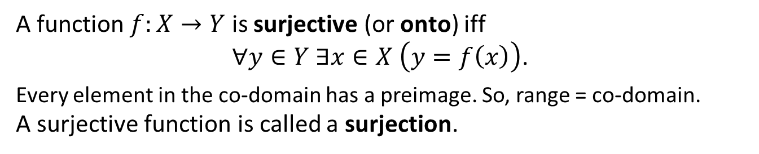
Definitions Injections, Surjections and Inverse Functions Composition of Functions
Surjections (Onto Functions)
7.2.2 Surjections (Onto Functions)
Definition: Surjection (onto function)
A function$f:X→Y$ is surjective (or onto) iff
$∀y∈Y ∃x∈X \left(y=f\left(x\right)\right)$.
Every element in the co-domain has a preimage. So, range = co-domain.
A surjective function is called a surjection.
Which of the following is/are surjections?
$$X$$
$$R_{4}$$
$$Y$$
$$X$$
$$R_{5}$$
$$Y$$
$$X$$
$$R_{6}$$
$$Y$$
Not surjection
Surjection
Surjection


Slide 28






Definitions Injections, Surjections and Inverse Functions Composition of Functions
Surjections (Onto Functions)
A function$f:X→Y$ is surjective iff
$∀y∈Y ∃x∈X \left(y=f\left(x\right)\right)$.
A function$f:X→Y$ is not surjective iff
$$∃y ∈Y ∀x∈X \left(y≠f\left(x\right)\right).$$
Example #16: Define a function $f:ℚ→ℚ$ by setting $f(x)=3x+1$ for all $x∈ℚ$. Is $f$ surjective?
Yes. Proof:
1. Take any $y∈ℚ$.
2. Let $x=(y−1)/3$.
3. Then $x∈ℚ$ and $f\left(x\right)=3x+1=3\left(\frac{y−1}{3}\right)+1=y$.
Example #17: Define $g:ℤ→ℤ$ by setting $g(x)=x^{2}$ for every $x∈ℤ$. Is $g$ surjective?
No.
$g\left(x\right)=x^{2}≥0>−1$ for all $x∈ℤ$.
So $g\left(x\right)≠−1$ for all $x∈ℤ$, although $−1∈ℤ$.

Slide 29

Definitions Injections, Surjections and Inverse Functions Composition of Functions
Bijections (One-to-One Correspondences)
7.2.3 Bijections (One-to-One Correspondences)
Definition: Bijection (one-to-one correspondence)
A function$f:X→Y$ is bijective iff $f$ is injective and surjective, i.e.
$$∀y∈Y ∃!x∈X \left(y=f\left(x\right)\right).$$
A bijective function is called a bijection or one-to-one correspondence.
Which of the following is/are bijections?
$$X$$
$$R_{4}$$
$$Y$$
$$X$$
$$R_{5}$$
$$Y$$
$$X$$
$$R_{6}$$
$$Y$$
Injection
Not injection
Injection
Not surjection
Surjection
Surjection

Bijection

Slide 30



Definitions Injections, Surjections and Inverse Functions Composition of Functions
Bijections (One-to-One Correspondences)
A function$f:X→Y$ is:
injective iff $∀x_{1},x_{2}∈X \left(f\left(x_{1}\right)=f\left(x_{2}\right)⇒x_{1}=x_{2}\right)$;
surjective iff $∀y∈Y ∃x∈X \left(y=f\left(x\right)\right)$;
bijective iff $∀y∈Y ∃!x∈X \left(y=f\left(x\right)\right)$.
(Injective) Informally, every element in the codomain must have at most one arrow going into it.
(Surjective) Informally, every element in the codomain must have at least one arrow going into it.
(Bijective) Informally, every element in the codomain must have exactly one arrow going into it.
$$∧$$
$$≡$$
$$X$$
$$R_{4}$$
$$Y$$
$$X$$
$$R_{5}$$
$$Y$$
$$X$$
$$R_{6}$$
$$Y$$
Injection
Not injection
Injection
Not surjection
Surjection
Surjection

Bijection

Slide 31






Definitions Injections, Surjections and Inverse Functions Composition of Functions
Inverse Functions
7.2.4 Inverse Functions
If $f$ is a bijection from $X$ to $Y$, then there is a function from $Y$ to $X$ that “undoes” the action of $f$; that is, it sends each element of $Y$ back to the element of $X$ that it came from. This function is called the inverse function for $f$, denoted as $f^{−1}.$
Definition: Inverse function
Let $f:X→Y$. Then $g:Y→X$ is an inverse of $f$ iff
$$∀x∈X ∀y∈Y \left(y=f\left(x\right)⇔x=g\left(y\right)\right) .$$
We denote the inverse of $f$ as $f^{−1}$.
$$X$$
$$Y$$
$$f$$
$$g$$

Slide 32


Definitions Injections, Surjections and Inverse Functions Composition of Functions
Inverse Functions
Definition: Inverse function
Let $f:X→Y$. Then $g:Y→X$ is an inverse of $f$ iff
$$∀x∈X ∀y∈y \left(y=f\left(x\right)⇔x=g\left(y\right)\right) .$$
We denote the inverse of $f$ as $f^{−1}$.
Example #18: Define $f:ℚ→ℚ$ by setting $f(x)=3x+1$ for all $x∈ℚ$. Note that for all $x,y∈ℚ, y=3x+1⇔x=(y−1)/3$.
Let $g:ℚ→ℚ$ such that $g(y)=(y−1)/3$for all $y∈ℚ$. Then the above tells us $∀x,y∈ℚ \left(y=f\left(x\right)⇔x=g\left(y\right)\right)$.
Therefore, $g$ is the inverse of $f$.

Slide 33
Definitions Injections, Surjections and Inverse Functions Composition of Functions
Slide 15 reproduced here.
Definitions: Setwise image and preimage
As the symbol for setwise preimage is $f^{−1}()$, which coincidentally is identical to the symbol for inverse function (see section 7.2.4), we use the notation $f^{−1}(α)$ to refer to the setwise preimage of a set $α$ (which is a subset of the co-domain), reserving the notation $f^{−1}(x)$ (where $x$ is a member of the co-domain) for the inverse function (if $f$ indeed has an inverse function). Note that in general $f^{−1}(α)$ needs not be a function, whereas $f^{−1}(x)$ must be a function.
Therefore, to denote the setwise preimage of a single element in the co-domain, eg: $b$, we would write $f^{−1}(\{b\})$ instead of $f^{−1}\left(b\right).$ (Because $f$ does not have an inverse function in this case.)
$$f^{−1}\left(\left\{b\right\}\right)=\left\{1,4\right\}.$$

Slide 34

Definitions Injections, Surjections and Inverse Functions Composition of Functions
Inverse Functions
Proposition: Uniqueness of inverses
If $g_{1}$ and $g_{2}$ are inverses of $f:X→Y$, then $g_{1}=g_{2}$.
Proof:
1. Note that $g_{1},g_{2}:Y→X$.
2. Since $g_{1}$ and $g_{2}$ are inverses of $f$, for all $x∈X$ and $y∈Y$, $x=g_{1}\left(y\right)⇔y=f(x)⇔x=g_{2}\left(y\right)$.
3. Therefore $g_{1}=g_{2}$.
Notes:
x

Slide 35


Definitions Injections, Surjections and Inverse Functions Composition of Functions
Bijectivity and Invertibility
7.2.5 Bijectivity and Invertibility
Theorem 7.2.3
If $f:X→Y$ is a bijection, then $f^{−1}:Y→X$ is also a bijection.
In other words, $f:X→Y$ is bijective iff $f$ has an inverse.
Proof: ($f:X→Y$ is bijective iff $f$ has an inverse)
1. (“if”) Suppose $f$ has an inverse, say $g:Y→X.$
1.1. We show injectivity of $f$.
1.1.1. Let $x_{1},x_{2}∈X$ such that $f\left(x_{1}\right)=f\left(x_{2}\right).$
1.1.2. Define $y=f\left(x_{1}\right)=f\left(x_{2}\right)$.
1.1.3. Then $x_{1}=g(y)$ and $x_{2}=g(y)$ as $g$ is an inverse of $f$.
1.1.4. Hence $x_{1}=$ $x_{2}$.
1.2. We show surjectivity of $f$.
1.2.1. Let $y∈Y$.
1.2.2. Define $x=g(y)$.
1.2.3. Then $y=f(x)$ as $g$ is an inverse of $f$.
1.3. Therefore $f$ is bijective.

Slide 36

Definitions Injections, Surjections and Inverse Functions Composition of Functions
Bijectivity and Invertibility
Theorem 7.2.3
If $f:X→Y$ is a bijection, then $f^{−1}:Y→X$ is also a bijection.
In other words, $f:X→Y$ is bijective iff $f$ has an inverse.
Proof: ($f:X→Y$ is bijective iff $f$ has an inverse)
1. (“if”) Suppose $f$ has an inverse, say $g:Y→X.$
2. (“only if”) Suppose $f$ is bijective.
2.1. Then $∀y∈Y ∃!x∈X \left(y=f\left(x\right)\right)$ by the definition of bijection.
2.2. Define the function $g:Y→X$ by setting $g(y)$ to be the unique $x∈X$ such that $y=f(x)$ for all $y∈Y$.
2.3. This $g$ is well defined and is an inverse of $f$ by the definition of inverse functions.
3. Therefore $f:X→Y$ is bijective iff $f$ has an inverse$.$

Slide 37
Definitions One-to-One, Onto and Inverse Functions Composition of Functions
7.3 Composition of Functions

Slide 38


Definitions One-to-One, Onto and Inverse Functions Composition of Functions
Composition of Functions
7.3.1 Composition of Functions
Consider two functions, the successor function and the squaring function, defined from $ℤ$ to $ℤ$, and imagine that each is represented by a machine.
If the two machines are hooked up so that the output from the successor function is used as input to the squaring function, then they work together to operate as one larger machine.
In this larger machine, an integer $n$ is first increased by 1 to obtain $n+1$; then the quantity $n+1$ is squared to obtain $(n+1)2$.
Combining functions in this way is called composing them; the resulting function is called the composition of the two functions.

Slide 39

Definitions One-to-One, Onto and Inverse Functions Composition of Functions
Composition of Functions
Definition: Composition of Functions
L$et f:X→Y$ and $g:Y→Z$ be functions.
Define a new function $g∘f:X→Z$ as follows:
$\left(g∘f\right)\left(x\right)=g\left(f\left(x\right)\right) ∀x∈X.$
where $g∘f$ is read “$g$ circle $f$” and $g\left(f\left(x\right)\right)$ is read “$g$ of $f$ of $x$”.
The function $g∘f$ is called the composition of $f$ and $g$.

Slide 40



























Definitions One-to-One, Onto and Inverse Functions Composition of Functions
Composition of Functions
Example #19: Let $X=\{1, 2, 3\}, Y=\{a, b, c, d\}$and $Z=\{x, y, z\}.$
Define functions $f:X→Y$and $g:Y→Z$by the arrow diagrams below.
$$X$$
$$Y$$
$$Z$$
$$f$$
$$a$$
$$g$$
Draw the arrow diagram for $g∘f$. What is the range of $g∘f$?
$$1$$
$$x$$
$$b$$
$$2$$
$$y$$
$$c$$
$$3$$
$$z$$
$$d$$
$$X$$
$$Z$$
$$1$$
$$g∘f$$
$$x$$
$$2$$
$$y$$
$$3$$
$$z$$
Therefore the range of $g∘f$is $\{y, z\}.$


Slide 41












Definitions One-to-One, Onto and Inverse Functions Composition of Functions
Composition with the Identity Function
7.3.2 Composition with the Identity Function
The identity function on a set $X$, $idX$, is the function from $X$ to $X$ defined by
${id}_{X}\left(x\right)=x$ for all $x∈X$.
Let $f:X→Y$.
(1) $f∘{id}_{X}=f$ because
Domains of $f∘{id}_{X}$ and $f$ are both $X$;
Co-domains of $f∘{id}_{X}$ and $f$ are both $Y$;
$\left(f∘{id}_{X}\right)\left(x\right)=f\left({id}_{X}\left(x\right)\right)=f(x)$ for all $x∈X$.
(2) ${id}_{Y}∘f=f$ because
Domains of ${id}_{Y}∘f$and $f$ are both $X$;
Co-domains of${id}_{Y}∘f$and $f$ are both $Y$;
$\left({id}_{Y}∘f\right)\left(x\right)={id}_{Y}\left(f\left(x\right)\right)=f(x)$ for all $x∈X$.
$${id}_{X}$$
$$X$$
$$X$$
$$f$$
$$f$$
$$f$$
$$Y$$
$$Y$$
$${id}_{Y}$$

Slide 42








Definitions One-to-One, Onto and Inverse Functions Composition of Functions
Composition with the Identity Function
Example #20: Let $X= \{a, b, c, d\}$and $Y=\{u, v, w\},$and suppose $f:X→Y$is given by the arrow diagram:
$f∘{id}_{X}=f$
Find $f∘{id}_{X}$
$$\left(f∘{id}_{X}\right)\left(a\right)=f\left({id}_{X}\left(a\right)\right)=f\left(a\right)=u$$
$$\left(f∘{id}_{X}\right)\left(b\right)=f\left({id}_{X}\left(b\right)\right)=f\left(b\right)=v$$
$$\left(f∘{id}_{X}\right)\left(c\right)=f\left({id}_{X}\left(c\right)\right)=f\left(c\right)=v$$
$$\left(f∘{id}_{X}\right)\left(d\right)=f\left({id}_{X}\left(d\right)\right)=f\left(d\right)=u$$
$${id}_{X}$$
$$\left(f∘{id}_{X}\right)\left(x\right)=f\left(x\right).$$

Slide 43







Definitions One-to-One, Onto and Inverse Functions Composition of Functions
Composition with the Identity Function
Example #21: Let $X= \{a, b, c, d\}$and $Y=\{u, v, w\},$and suppose $f:X→Y$is given by the arrow diagram:
${id}_{Y}∘f=f$
Find ${id}_{Y}∘f$
$$\left({id}_{Y}∘f\right)\left(a\right)={id}_{Y}\left(f\left(a\right)\right)=f\left(a\right)=u$$
$$\left({id}_{Y}∘f\right)\left(b\right)={id}_{Y}\left(f\left(b\right)\right)=f\left(b\right)=v$$
$$\left({id}_{Y}∘f\right)\left(c\right)={id}_{Y}\left(f\left(c\right)\right)=f\left(c\right)=v$$
$$\left({id}_{Y}∘f\right)\left(d\right)={id}_{Y}\left(f\left(d\right)\right)=f\left(d\right)=u$$
$${id}_{Y}$$
$$\left({id}_{Y}∘f\right)\left(x\right)=f\left(x\right).$$

Slide 44

Definitions One-to-One, Onto and Inverse Functions Composition of Functions
Composition with the Identity Function
Theorem 7.3.1 Composition with an Identity Function
If $f$ is a function from a set $X$ to a set $Y$, and ${id}_{X}$ is the identity function on $X$, and ${id}_{Y}$ is the identity function on $Y$, then
$f∘{id}_{X}=f$ and
${id}_{Y}∘f=f$

Slide 45




Definitions One-to-One, Onto and Inverse Functions Composition of Functions
Composing a Function with Its Inverse
7.3.3 Composing a Function with Its Inverse
Example #22: Let $X=\{a, b, c\}$and $Y=\{x, y, z\}.$Define $f:X→Y$by the following arrow diagram.
Then $f$ is a bijection. Thus $f^{−1}$ exists and is found by tracing the arrows backwards, as shown below.

Slide 46





Definitions One-to-One, Onto and Inverse Functions Composition of Functions
Composing a Function with Its Inverse
Now $f^{−1}∘f$ is found by following the arrows from $X$ to $Y$ by $f$ and back to $X$ by $f^{−1}$.
$$\left(f^{−1}∘f\right)\left(a\right)=f^{−1}\left(f\left(a\right)\right)=f^{−1}\left(z\right)=a$$
$$\left(f^{−1}∘f\right)\left(b\right)=f^{−1}\left(f\left(b\right)\right)=f^{−1}\left(x\right)=b$$
$$\left(f^{−1}∘f\right)\left(c\right)=f^{−1}\left(f\left(c\right)\right)=f^{−1}\left(y\right)=c$$
Therefore, $f^{−1}∘f={id}_{X}$.
Similarly, $f∘f^{−1}={id}_{Y}$.
Theorem 7.3.2 Composition of a Function with Its Inverse
If $f:X→Y$ is a bijection with inverse function $f^{−1}:Y→X$, then
$f^{−1}∘f={id}_{X}$ and $f∘f^{−1}={id}_{Y}$

Slide 47












Definitions One-to-One, Onto and Inverse Functions Composition of Functions
Associativity of Function Composition
7.3.4 Associativity of Function Composition
Function composition. L$et f:X→Y$ and $g:Y→Z$.
Then $g∘f:X→Z$ such that for every $x∈X, \left(g∘f\right)\left(x\right)=g\left(f\left(x\right)\right).$
Theorem: Associativity of Function Composition
Let $f:A→B, g:B→C$ and $h:C→D$. Then
$\left(h∘g\right)∘f=h∘(g∘f)$.
Function composition is associative.
$$f$$
$$A$$
$$B$$
$$g$$
$$h∘g$$
Proof:
1. The domains of $\left(h∘g\right)∘f$ and $h∘(g∘f)$are both $A$.
2. The codomains of $\left(h∘g\right)∘f$ and $h∘(g∘f)$are both $D$.
3. For every $x∈A$, $$\left(\left(h∘g\right)∘f\right)\left(x\right)=\left(h∘g\right)\left(f\left(x\right)\right)=h\left(g\left(f\left(x\right)\right)\right)=h\left(\left(g∘f\right)\left(x\right)\right)=\left(h∘\left(g∘f\right)\right)(x).$$
$$g∘f$$
$$C$$
$$D$$
$$h$$

Slide 48


Definitions One-to-One, Onto and Inverse Functions Composition of Functions
Noncommutativity of Function Composition
7.3.5 Noncommutativity of Function Composition
Function composition. L$et f:X→Y$ and $g:Y→Z$.
Then $g∘f:X→Z$ such that for every $x∈X, \left(g∘f\right)\left(x\right)=g\left(f\left(x\right)\right).$
Example #23: Let $f,g:ℤ→ℤ$ such that for every $x∈ℤ$,
$f\left(x\right)=3x$ and $g\left(x\right)=x+1$.
Then for every $x∈ℤ$,
$\left(g∘f\right)\left(x\right)=g\left(f\left(x\right)\right)=g\left(3x\right)=3x+1$
and
$\left(f∘g\right)\left(x\right)=f\left(g\left(x\right)\right)=f\left(x+1\right)=3(x+1)$.
Note that $\left(g∘f\right)\left(0\right)=1≠3=(f∘g)(0)$.

Slide 49





Definitions One-to-One, Onto and Inverse Functions Composition of Functions
Composition of Injections
7.3.6 Composition of Injections
Example #24:
Let $X=\{a, b, c\}, Y=\{w, x, y, z\},$ and $Z=\{1, 2, 3, 4, 5\},$and define injections $f: X→Y$and $g:Y→Z$ as shown in the arrow diagrams of Figure 7.3.1.
Figure 7.3.1
Then $g∘f$ is the function with the arrow diagram shown in Figure 7.3.2.
Is $g∘f$ injective?
Yes.
Figure 7.3.2

Slide 50


Definitions One-to-One, Onto and Inverse Functions Composition of Functions
Composition of Injections
Theorem 7.3.3
If $f:X→Y$ and $g:Y→Z$ are both injective, then $g∘f$ is injective.
Proof:
1. Suppose $f:X→Y$ and $g:Y→Z$ are injections and let $x_{1},x_{2}∈X$ such that $\left(g∘f\right)\left(x_{1}\right)=\left(g∘f\right)\left(x_{2}\right)$.
2. Then $(g\left(f\left(x_{1}\right)\right)=g\left(f\left(x_{2}\right)\right)$ by the definition of function composition.
3. Since $g$ is injective, so $f\left(x_{1}\right)=f\left(x_{2}\right)$ by the definition of injection.
4. Since $f$ is injective, so $x_{1}=x_{2}$ by the definition of injection.
5. Therefore $g∘f$ is injective.
A function$f:X→Y$ is injective iff
$$∀x_{1},x_{2}∈X \left(f\left(x_{1}\right)=f\left(x_{2}\right)⇒x_{1}=x_{2}\right).$$

Slide 51





Definitions One-to-One, Onto and Inverse Functions Composition of Functions
Composition of Surjections
7.3.7 Composition of Surjections
Example #25:
Let $X=\left\{a, b, c, d, e\right\}, Y=\left\{w, x, y, z\right\},$ and $Z=\{1, 2, 3\},$ and define surjections
$f:X→Y$and $g:Y→Z$as shown in the arrow diagrams on the right.
Then $g∘f$ is the function with the arrow diagram on the right.
Is $g∘f$ surjective?
Yes.

Slide 52


Definitions One-to-One, Onto and Inverse Functions Composition of Functions
Composition of Surjections
Theorem 7.3.4
If $f:X→Y$ and $g:Y→Z$ are both surjective, then $g∘f$ is surjective.
Proof:
1. Suppose $f:X→Y$ and $g:Y→Z$ are surjections and let $z∈Z$.
2. Since $g$ is surjective, so there is an element $y∈Y$ such that $g(y)=z$ by the definition of surjection.
3. Since $f$ is surjective, so there is an element $x∈X$ such that $f(x)=y$ by the definition of surjection.
Hence there exists an element $x∈X$ such that
$\left(g∘f\right)\left(x\right)=g\left(f\left(x\right)\right)=g\left(y\right)=z$.
5. Therefore $g∘f$ is surjective.
A function$f:X→Y$ is surjective iff
$∀y∈Y ∃x∈X \left(y=f\left(x\right)\right)$.

Slide 53

Addition and Multiplication Functions on $ℤ_{n}$
7.4 Addition and Multiplication Functions on $ℤ_{n}$

Slide 54






Addition and Multiplication Functions on $ℤ_{n}$
Definitions
7.4.1 Definitions (from Lecture #6)
Definition: Congruence
Proposition
Let $a,b∈ℤ$ and $n∈ℤ^{+}$. Then $a$ is congruent to $b$ modulo $n$ iff $a−b=nk$ for some $k∈ℤ.$ In other words, $n | \left(a−b\right).$
In this case, we write $a≡b (mod n)$.
Congruence-mod $n$ is an equivalence relation on $ℤ$ for every $n∈ℤ^{+}$.
Definition: Equivalence Class
Definition: Set of equivalence classes
Suppose $A$ is a set and $\sim$ is an equivalence relation on $A$. The equivalence class of $a∈A$, is
${[a]}_{\sim }=\{x∈A :a\sim x \}$.
Let $A$ be a set and $\sim$ be an equivalence relation on $A$. Denote by $A/\sim$ the set of all equivalence classes with respect to $\sim$, i.e.,
$A/\sim$ $=\left\{{\left[x\right]}_{\sim } :x∈A\right\}.$
We may read $A/\sim$ as “the quotient of $A$ by $\sim$”.
Now, we introduce a notation $ℤ_{n}$:
The quotient $ℤ/\sim _{n}$ where $\sim _{n}$ is the congruence-mod-$n$ relation on $ℤ$, is denoted $ℤ_{n}$.

Slide 55








Addition and Multiplication Functions on $ℤ_{n}$
Definition: $ℤ_{n}$
The quotient $ℤ/\sim _{n}$ where $\sim _{n}$ is the congruence-mod-$n$ relation on $ℤ$, is denoted $ℤ_{n}$.
From Lecture #6:
Congruence modulo 2
Congruence modulo 3
Congruence modulo 4
:
-4
-2
0
2
4
:
:
-3
-1
1
3
5
:
$$ℤ$$
:
-6
-3
0
3
6
:
:
-5
-2
1
4
7
:
:
-4
-1
2
5
8
:
$$ℤ$$
:
-8
-4
0
4
8
:
:
-7
-3
1
5
9
:
:
-6
-2
2
6
10
:
:
-5
-1
3
7
11
:
$$ℤ$$
Partition of $ℤ$:
$$\left\{\begin{aligned}\left\{2k :k∈ℤ\right\}, \\ \left\{2k+1 :k∈ℤ\right\}\end{aligned}\right\}$$
Partition of $ℤ$:
$$\left\{\begin{aligned}\left\{3k :k∈ℤ\right\}, \\ \left\{3k+1 :k∈ℤ\right\}, \\ \left\{3k+2 :k∈ℤ\right\}\end{aligned}\right\}$$
Partition of $ℤ$:
$$\left\{\begin{aligned}\left\{4k :k∈ℤ\right\}, \\ \left\{4k+1 :k∈ℤ\right\}, \\ \begin{aligned}\left\{4k+2 :k∈ℤ\right\}, \\ \left\{4k+3 :k∈ℤ\right\}\end{aligned}\end{aligned}\right\}$$
$$ℤ_{2}=\left\{\left\{2k:k∈ℤ\right\},\{2k+1: k∈ℤ\}\right\}$$
$$ℤ_{3}=\left\{\left\{3k:k∈ℤ\right\}, \left\{3k+1: k∈ℤ\right\}\text{,} \{3k+2: k∈ℤ\}\right\}$$
$$ℤ_{4}=\left\{\left\{4k:k∈ℤ\right\}, \left\{4k+1: k∈ℤ\right\}\text{,} \left\{4k+2: k∈ℤ\right\},\{4k+3: k∈ℤ\}\right\}$$

Slide 56



Addition and Multiplication Functions on $ℤ_{n}$
Addition and Multiplication on $ℤ_{n}$
7.4.2 Addition and Multiplication on $ℤ_{n}$
Definition: Addition and Multiplication on $ℤ_{n}$
Define addition $+$ and multiplication $∙$ on $ℤ_{n}$ as follows:
whenever $\left[x\right],[y]∈ℤ_{n}$,
$\left[x\right]+\left[y\right]=[x+y]$ and $\left[x\right]∙[y]=[x∙y]$
Example #26:
Take $[0],[1]∈ℤ_{3}$,
Then $\left[0\right]+\left[1\right]=\left[0+1\right]=[1]$ (which is $\{…,−5,−2,1,4,7,…\}$)
and $\left[0\right]∙\left[1\right]=\left[0∙1\right]=\left[0\right]$ (which is $\{…,−6,−3,0,3,6,…\}$).

Slide 57



Addition and Multiplication Functions on $ℤ_{n}$
Addition and Multiplication on $ℤ_{n}$
Proposition: Addition on $ℤ_{n}$ is well defined
For all $n∈ℤ^{+}$ and all $\left[x_{1}\right],\left[y_{1}\right],\left[x_{2}\right],\left[y_{2}\right]∈ℤ_{n},$
$\left[x_{1}\right]=[x_{2}]$ and $\left[y_{1}\right]=\left[y_{2}\right]⇒$ $\left[x_{1}\right]+\left[y_{1}\right]=\left[x_{2}\right]+\left[y_{2}\right].$
Proof:
1. Let $\left[x_{1}\right],\left[y_{1}\right],\left[x_{2}\right],\left[y_{2}\right]∈ℤ_{n}$ such that $\left[x_{1}\right]=[x_{2}]$ and $\left[y_{1}\right]=\left[y_{2}\right]$.
2. Then $x_{1}≡x_{2} (mod n)$ and $y_{1}≡y_{2} (mod n)$ by the definition of congruence.
3. Use the definition of congruence to find $k,l∈ℤ$ such that
$x_{1}−x_{2}=nk$ and $y_{1}−y_{2}=nl$.
4. Note that ${(x}_{1}+y_{1})−\left(x_{2}+y_{2}\right)=\left(x_{1}−x_{2}\right)+\left(y_{1}−y_{2}\right)=nk+nl=n\left(k+l\right).$
5. So $x_{1}+y_{1}≡x_{2}+y_{2} (mod n)$ by the definition of congruence.
6. Therefore, $\left[x_{1}\right]+\left[y_{1}\right]=\left[x_{1}+y_{1}\right]=\left[x_{2}+y_{2}\right]=\left[x_{2}\right]+\left[y_{2}\right]$ by the lemma below.
Lemma Rel.1 Equivalence Classes
Let $\sim$ be an equivalence relation on a set $A$. The following are equivalent for all $x,y∈A$. (i) $x\sim y;$(ii) $\left[x\right]=\left[y\right];$ (iii) $\left[x\right]∩[y]≠∅$.

Slide 58


Addition and Multiplication Functions on $ℤ_{n}$
Addition and Multiplication on $ℤ_{n}$
Proposition: Multiplication on $ℤ_{n}$ is well defined
For all $n∈ℤ^{+}$ and all $\left[x_{1}\right],\left[y_{1}\right],\left[x_{2}\right],\left[y_{2}\right]∈ℤ_{n},$
$\left[x_{1}\right]=[x_{2}]$ and $\left[y_{1}\right]=\left[y_{2}\right]⇒$ $\left[x_{1}\right]∙\left[y_{1}\right]=\left[x_{2}\right]∙\left[y_{2}\right].$
Proof:
1. Let $\left[x_{1}\right],\left[y_{1}\right],\left[x_{2}\right],\left[y_{2}\right]∈ℤ_{n}$ such that $\left[x_{1}\right]=[x_{2}]$ and $\left[y_{1}\right]=\left[y_{2}\right]$.
2. Then $x_{1}≡x_{2} (mod n)$ and $y_{1}≡y_{2} (mod n)$ by the definition of congruence.
3. Use the definition of congruence to find $k,l∈ℤ$ such that
$x_{1}−x_{2}=nk$ and $y_{1}−y_{2}=nl$.
Note that ${(x}_{1}∙y_{1})−\left(x_{2}∙y_{2}\right)=\left(nk+x_{2}\right)∙\left(nl+y_{2}\right)−\left(x_{2}∙y_{2}\right)$
$=n\left(nkl+ky_{2}+lx_{2}\right)$, where $(nkl+ky_{2}+lx_{2})∈ℤ$ (by closure of integer addition)
5. So $x_{1}∙y_{1}≡x_{2}∙y_{2} (mod n)$ by the definition of congruence.
6. Therefore, $\left[x_{1}\right]∙\left[y_{1}\right]=\left[x_{1}∙y_{1}\right]=\left[x_{2}∙y_{2}\right]=\left[x_{2}\right]∙\left[y_{2}\right]$ by the lemma below.
Lemma Rel.1 Equivalence Classes
Let $\sim$ be an equivalence relation on a set $A$. The following are equivalent for all $x,y∈A$. (i) $x\sim y;$(ii) $\left[x\right]=\left[y\right];$ (iii) $\left[x\right]∩[y]≠∅$.

Slide 59
END OF FILE

